Slide 1
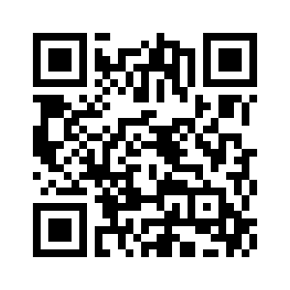
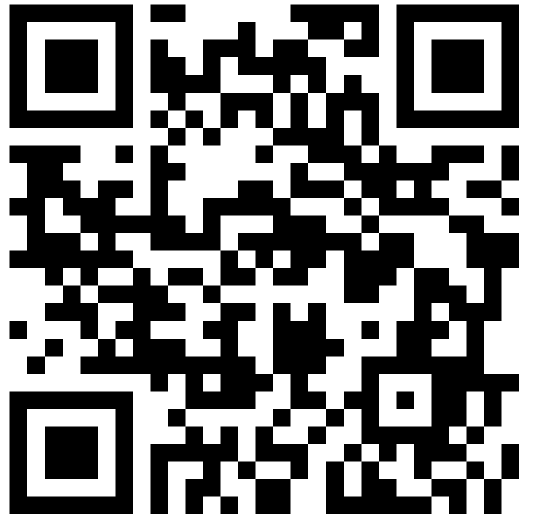
Feedback Control 2
COMSM4111 Robotic Systems
Anonymous Feedback form:
https://forms.gle/PyQQy2mwzyATFmJW6
Padlet board (questions & comments):
http://padlet.com/paul_odowd1/1lhoodwv2fuc
Delivered by:
Paul O’Dowd paul.odowd@bristol.ac.uk

Slide 2
House Keeping

Slide 3
Lab Sessions / Sheets
Week 1
Week 2
Week 3
Week 4
Week 5
Week 6
Week 7
Meet the Romi
Millis()
Encoders
PID
Line Following
Finite State Machine
Motors
Time & Speed
Kinematics
Lectures
Intro
Sensors & Actuators
Feedback Control 2
Probabilistic Robotics
System
Architectures
Path Planning
Experimental Robotics
Micro-controllers
Feedback Control 1
Kinematics
PID Drop-In
Sensor Fusion
Searching & Mapping
Toward
Assessment 2
Assessment Op 1
Assessment Op 2
Assessment Op 3

Slide 4
This Lecture:
PID Theory Resources
Live Coding
Notes:
The learning outcomes for this lecture are to:
Grasp a fundamental (deep) understanding of how we use microcontroller peripherals like Timers, Interrupts, etc.
This means knowing something of how computers work…
…and why we then write software the way we do.
Ordinarily, this is difficult to grasp by ‘just doing it’, it needs to be taught.
We will also looks at how it is done on Arduino (surface level understanding).
You should be able to apply all this in the lab session.
Hopefully, the strange software will make more sense after this.

Slide 5
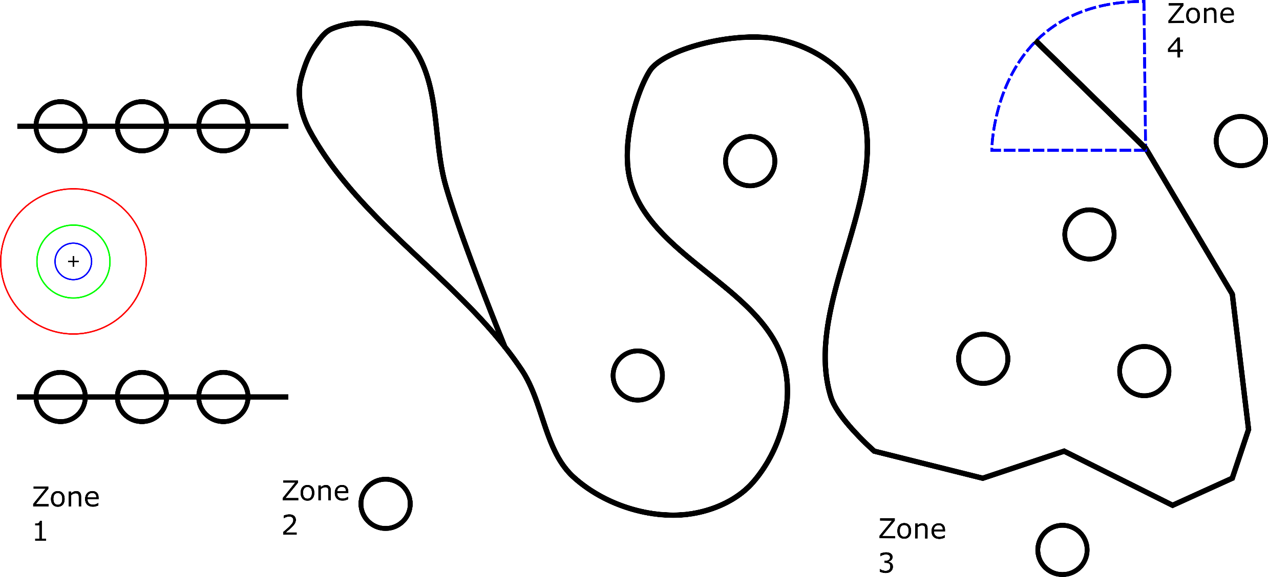
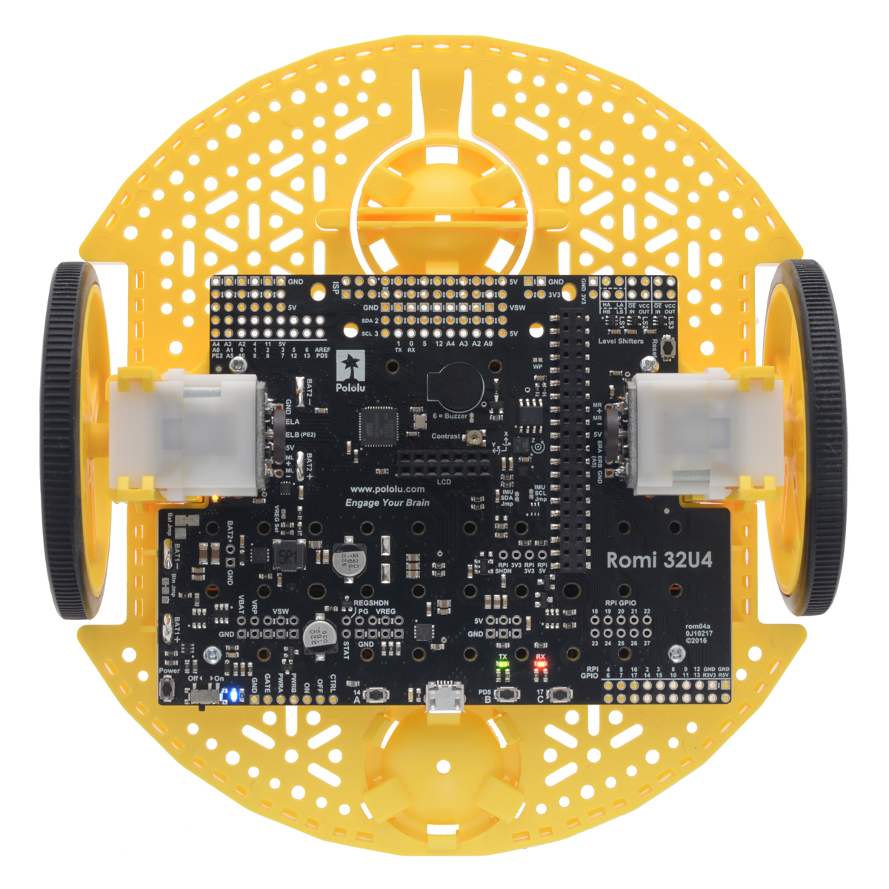
Assessment 1:
Notes:
For coursework 1, your robot will have to follow a line something like this.
Each ‘zone’ of the line challenge presents learning challenges for you.
Each of these challenges is supported with the lab sessions.
We will review this in more detail with the CW1 specification sheet.

Slide 6
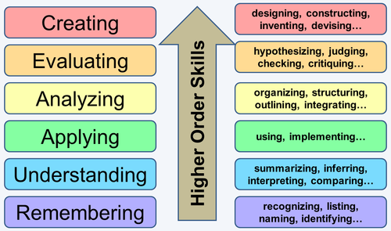
Learning Theory: Blooms Taxonomy (the way we designed this unit)
Assessment 2
Freedom to
Explore &
Demonstrate
Higher Understanding
Assessment 1
Driving Lessons
Driving Test

Slide 7
PID Theory Resources
Google “beginners PID”
http://brettbeauregard.com/blog/2011/04/improving-the-beginners-pid-introduction/
A good video:
https://youtu.be/JFTJ2SS4xyA

Slide 8
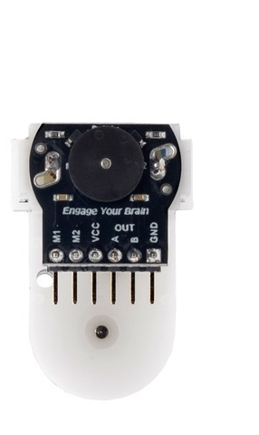
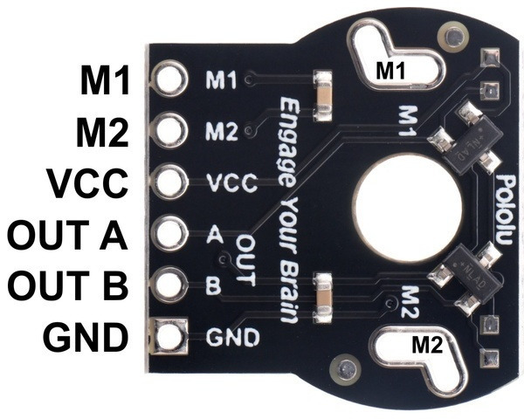
Encoders

Slide 9
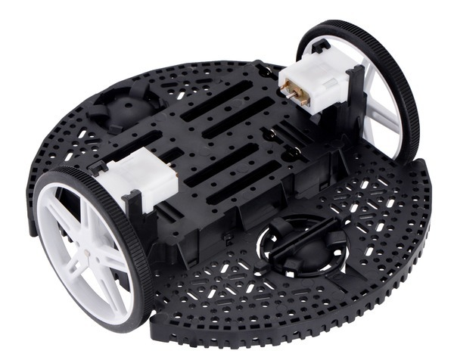
Encoders
+1
+1
Tracking over time provides
Angular Speed
+1
+1
PID Speed Controller
+1
Using geometry of robot,
can calculate distance
covered.
+1
+1
+1
+1
PID Position Controller

Slide 10
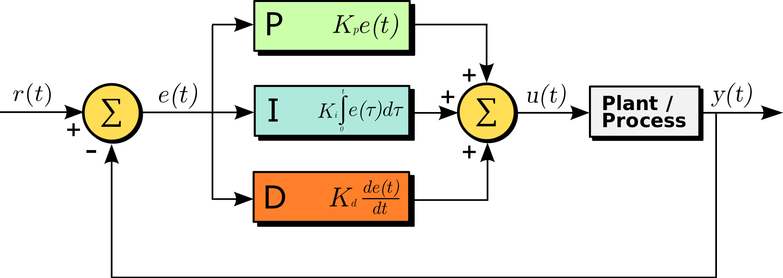

Closed Loop Control
Demand
Feedback
Output
Measurement

Slide 11
Closed Loop Control
p-term
i-term
d-term

Slide 12
Closed Loop Control
Kp, Ki, and Kd are “gain” values.
Used to control the contribution of the p-term, i-term and d-term respectively.
p-term
i-term
d-term

Slide 13
Closed Loop Control
Kp, Ki, and Kd are “gain” values.
Used to control the contribution of the p-term, i-term and d-term respectively.
Encoder
measurement
output
signal
p-term
i-term
d-term

Slide 14
Live Coding

Slide 15
PID Tuning Tips
Trial-and-Error
Start with Proportional Only
Find the gain value for closest undershoot
Find the gain value for first instance of oscillation
Try to dampen oscillation with Derivative
You may need to lower your Kp
You will probably still see undershoot (steady-state error)
But see if you can decrease the rise time whilst keeping overshoot low.
Compensate for undershoot by adding in the i-term
Start with very small values of Ki.

Slide 16
Q&A
Anonymous Feedback form:
https://forms.gle/PyQQy2mwzyATFmJW6
Padlet board (questions & comments):
http://padlet.com/paul_odowd1/1lhoodwv2fuc
Delivered by:
Paul O’Dowd paul.odowd@bristol.ac.uk

